Slide 1
Game Development Port folio
Charles THOMAS MERRICK Bisset
b00314125

Slide 2
The Game Idea
The main concept of the game is a chose your own path platformer.
By pick your own path I mean there are multiple level types dark worlds and light worlds.
The story of the game is basically you’re a very famous archer just about to get knighted and all hell breaks loose literally. You wake up bodied burned and covered with a cloak with nothing but rage filling you.Will you chose the light or the dark that decision is yours alone.

Slide 3
Concepts and Gameplay mechanics
The concept itself is based loosely on the legend of Zelda series and the castlevania series. More castlevaina for gameplay and the legend of Zelda for story and level design. The main gameplay mechanics include giving the player the choice of two weapon the sword or the bow. With the bow doing dramatically more damage because the main character is a famous archer not a swordsmen so basically bow play is easy mode and sword is hard mode.
The player will have the ability to jump and the ability to dodge roll away from enemies. The finished version will allow the player to interact with towns people if they chose the light levels.
Enemies include the undead who mostly carry lances and turrets set up to do you damage. The objective is to get to the end of the level and make your next choice.

Slide 4
Game Engine and Assets used
The main game engine of my chose was unity. I chose it just as a personal preference the 2019 version.
Assets used were all borrowed from unity asset store. These include the following. 2DBasicPlatformerPack, 8BitSounds, Gothicvania Cemetery Artwork, GothicVania Church, Gothicvania Swamp Artwork, Gothicvania-Town, Platformer Template

Slide 5

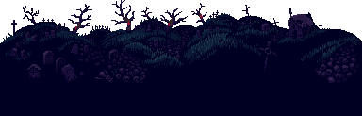

Slide 6
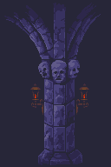
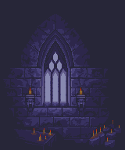
More assets

Slide 7
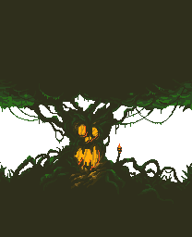

More assets

Slide 8



More assets

Slide 9
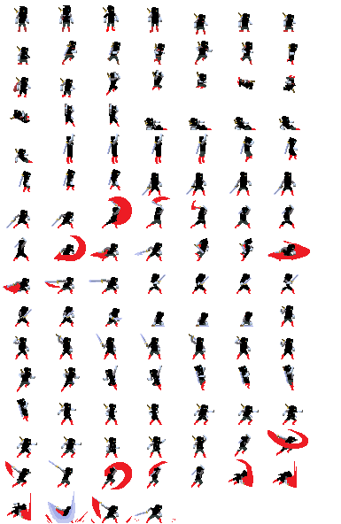
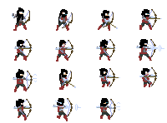
More assets

Slide 10
Project Management and Team Memebers
So project management was pretty easy this time im the only team member
Basically I just followed my calendar and did different tasks each day
Im the only team member I play every role.

Slide 11
Link to current demo
https://www.youtube.com/watch?v=REKkngOrhcA&feature=youtu.be

